Slide 1


Individual Research Project
DataWise

Slide 2
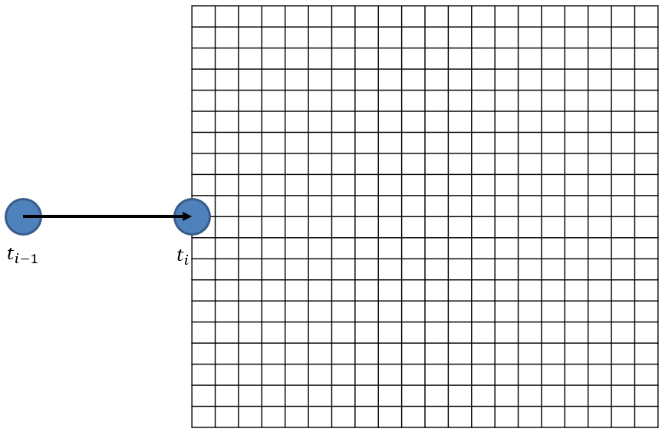

nx
nz
ny

Slide 3
Outline
Introduction
I – Literature Review
Federated Learning and/or Edge Computing ?
Research on ATM
Challenges
II – Coding
Problematic to solve
Framework & advancement so far
III – Timeline: Gantt chart & next steps

Slide 4
Introduction
Project goal: Analyze and reduce the existing Air Traffic Management (ATM) system in order to prevent future issues related to an increasing number of stakeholders and volume of data transferred
“Stakeholder” can mean aircrafts as well as ground stations.
Increasing data volumes (in terms of communication and storage) are costly and cause database queries to be slower
→ Potential security hazard
We want to find ways to reduce this ATM system using Artificial Intelligence

Slide 5

I - Federated Learning
Central server and clients are organized in a star pattern​
The central server sends an instruction to all client nodes to train a specific model (e.g., neural network, linear regression…)​
A fraction of the clients trains the chosen model locally, with the data it has stored​
The clients send their trained model to the central server which averages them out and sends back the obtained model​
The clients and server repeat this cycle until a stopping criterion is met (accuracy threshold, max number of cycles…)

Slide 6
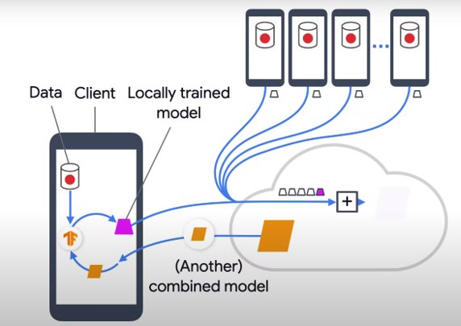
For example, Google uses Federated Learning (FL) to improve user experience on their mobile devices (e.g. with personalized speech prediction)

Slide 7
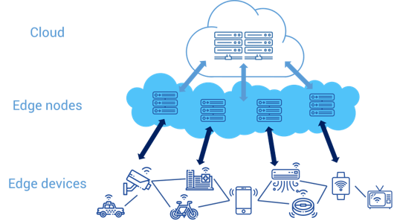
Edge Computing
Process the data near the data source​
Send only the processed and reduced data to the cloud / central server​
Mostly suitable for connected devices and their large amount of sensors

Slide 8
Edge Computing does not seem suitable to our case, unless we agree to create edge servers in our ATM system
Federated Learning
Pro’s:
Data privacy​
Takes advantage of computing power of clients
Can improve user experience
Con’s :​
Possible bottleneck effect on central server​
Non-i.i.d. datasets may distort the final model
Many ways to improve FL found in the literature

Slide 9
Common challenges associated with FL
Expensive communications​
Systems heterogeneity​
Statistical heterogeneity​
Privacy concerns

Slide 10
How to improve data handling in the existing ATM system
Better database indexing methods
Compression methods using similarities in the data
4D data cleansing (e.g., fixing missing, duplicated or wrong 4D datapoints)

Slide 11
II - Coding
Problem to solve :
Train a neural network that will be able to predict 4D trajectories based on weather data and flight plans.
Both the aircraft and the Ground Station (GS) hold a copy of the network to make predictions.
After take-off, if the flight “goes as planned”, no air-ground communication is needed.
Federated Learning process for the training phase

Slide 12
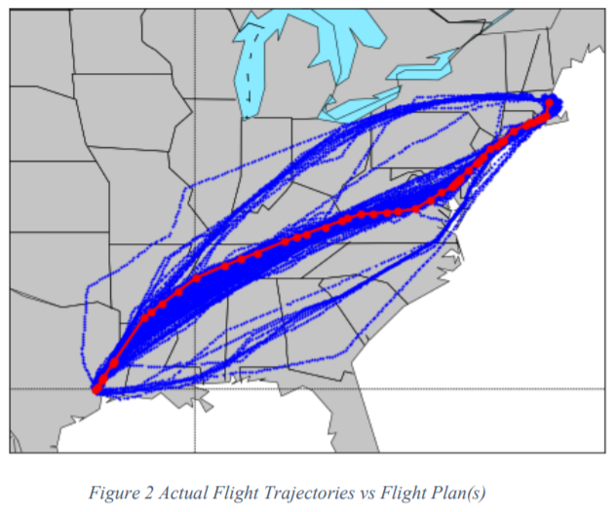
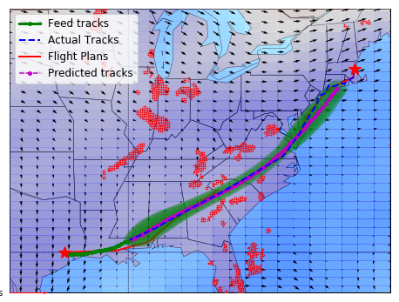
Main weather factors influencing trajectories :
Temperature
Wind
Air convective cells
Airplanes have a flight plan, but their actual trajectory diverts a lot from it

Slide 13
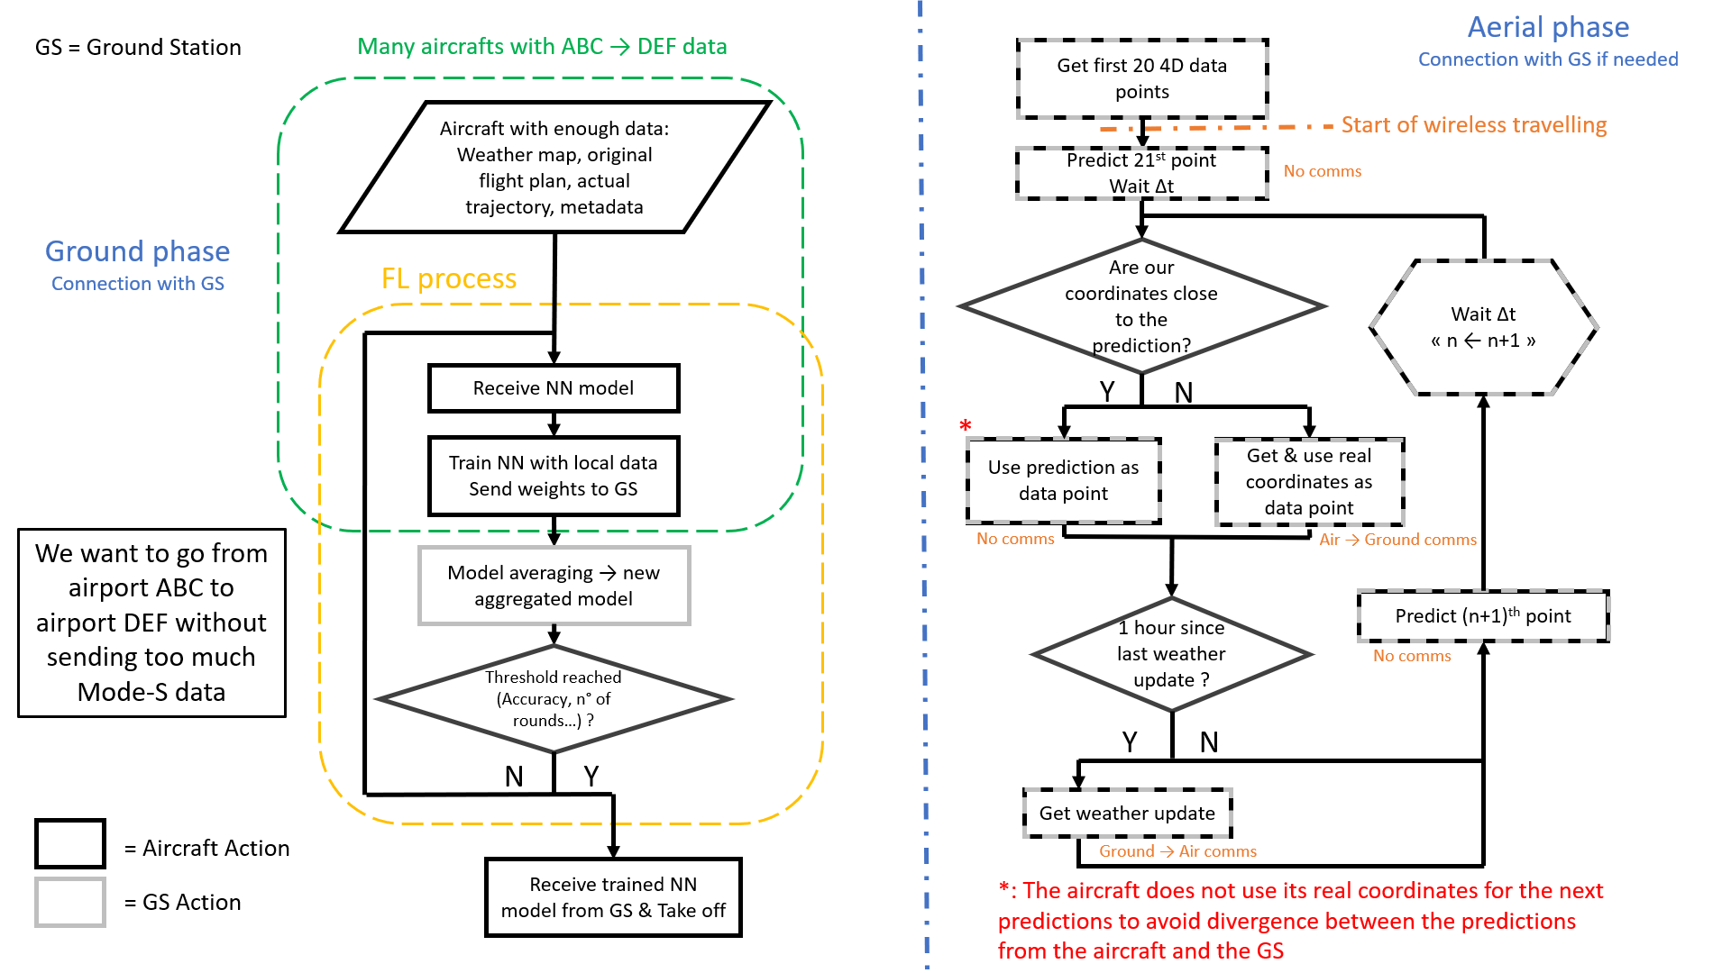

Slide 14


Prediction (GS)
T_{i}
T_{i+1}
T_{i+2}
Prediction (plane)
Predicted point (GS) & threshold
Predicted point (plane) & threshold
Point used for next prediction (GS)
Point used for next prediction (plane)
Ground Station

Slide 15
T_{i}
T_{i}
T_{i+1}
T_{i+2}
T_{i+3}
Prediction made at T_{i}
Predicted point & threshold (GS & plane)
Point used for next prediction (GS & plane)
Mode-S Communication
Ground Station

Slide 16
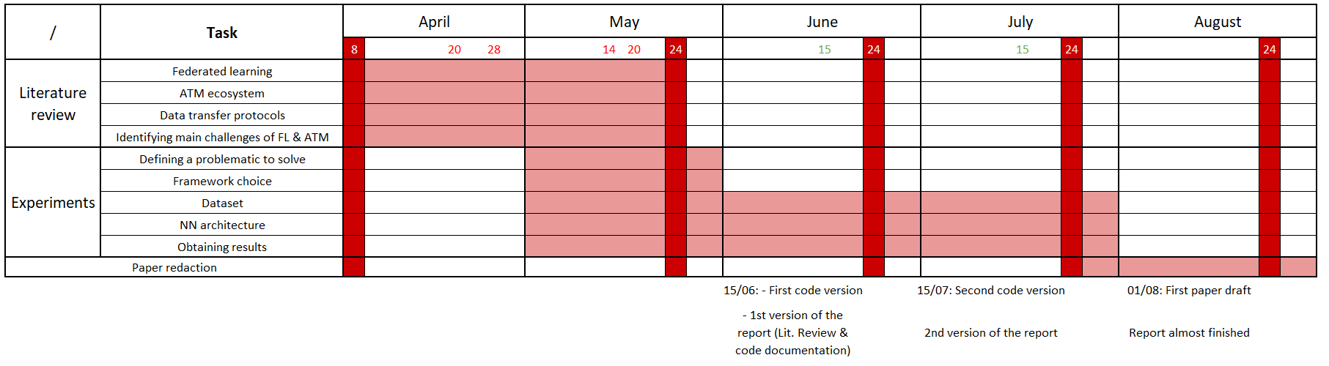
Timeline

Slide 17
Thank you for your attention !

